Slide 1
Satellites and Plato
Using GIS to see the effects of ideas
Kass Mattingly

Slide 2
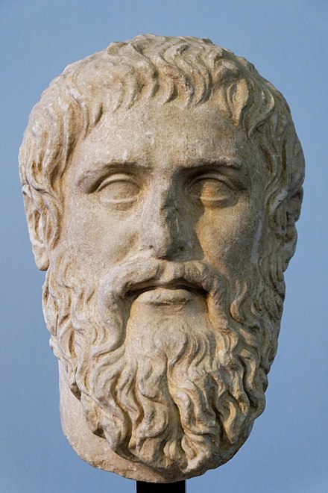
Plato’s Perfect City
Isolated
Fortified acropolis
City divided into 12 sections
Ring wall

Slide 3
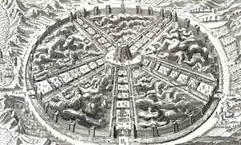
“the building of the private houses must be arranged from the start in such a way that the whole city may form a single wall; all the houses must have good walls, built regularly and in a similar style, facing the roads so that the whole city will have the form of a single house, which will render its appearance not unpleasing, besides being far and away the best plan for ensuring safety and ease of defense” (7798).

Slide 4
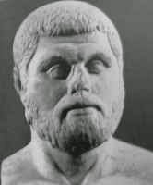
Hippodamian Cities
Grid Layout
Wide Streets
Cross at right angles
Central Agora

Slide 5
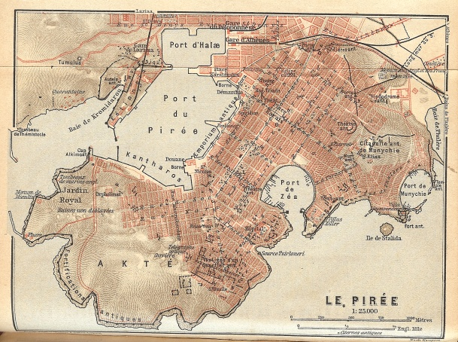
Piraeus, port of Athens

Slide 6

What is GIS?
Geographic Information System(s)
Space Archaeology!
More than bird’s eye view

Slide 7
Digitizing Cities
Empuries
Kamiros
Olythus

Slide 8
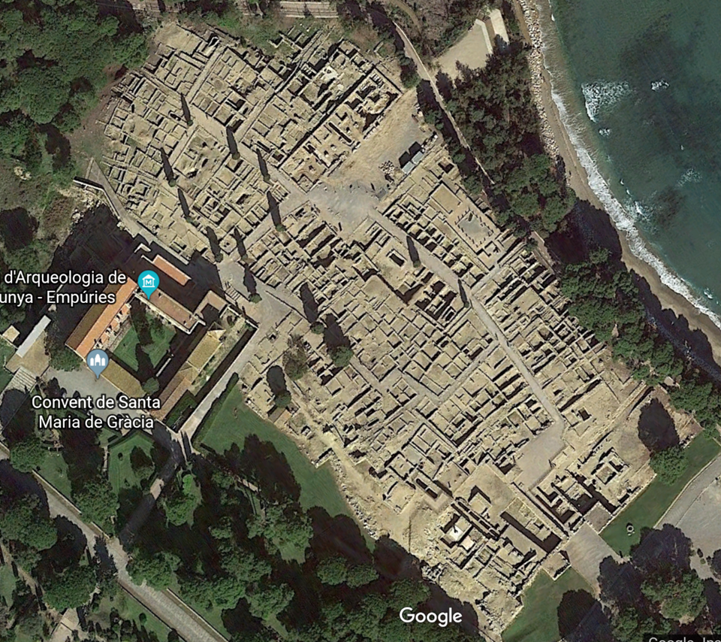
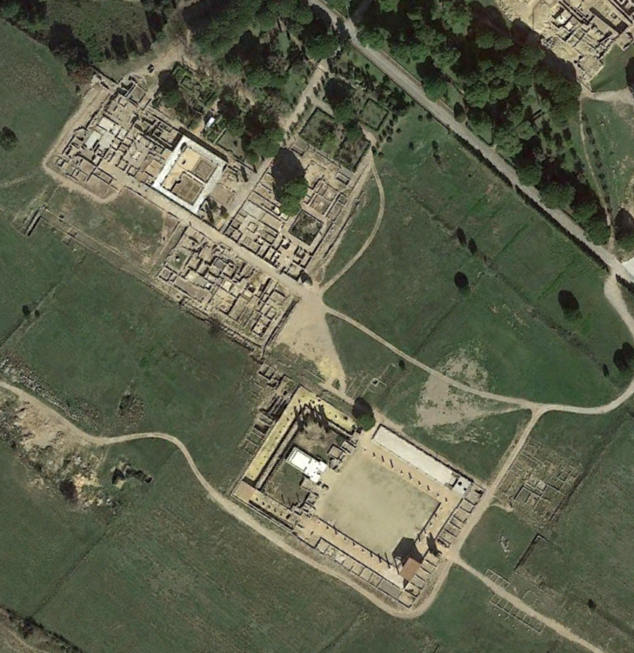

Slide 9
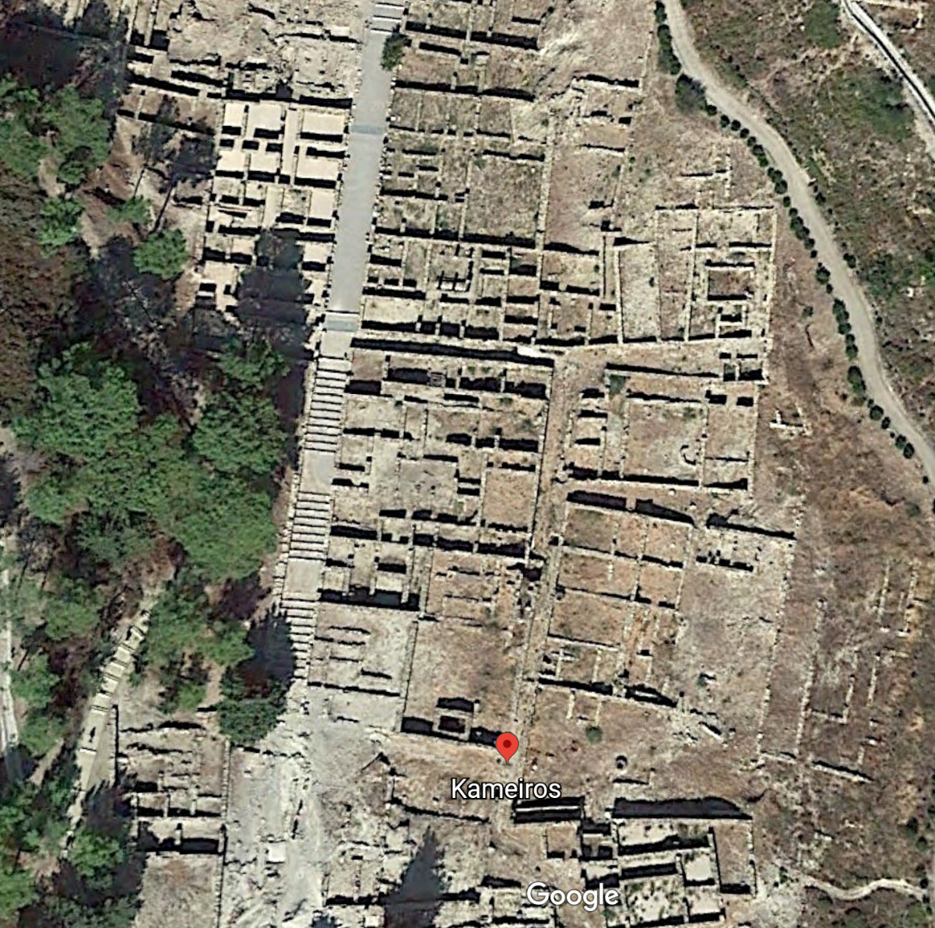
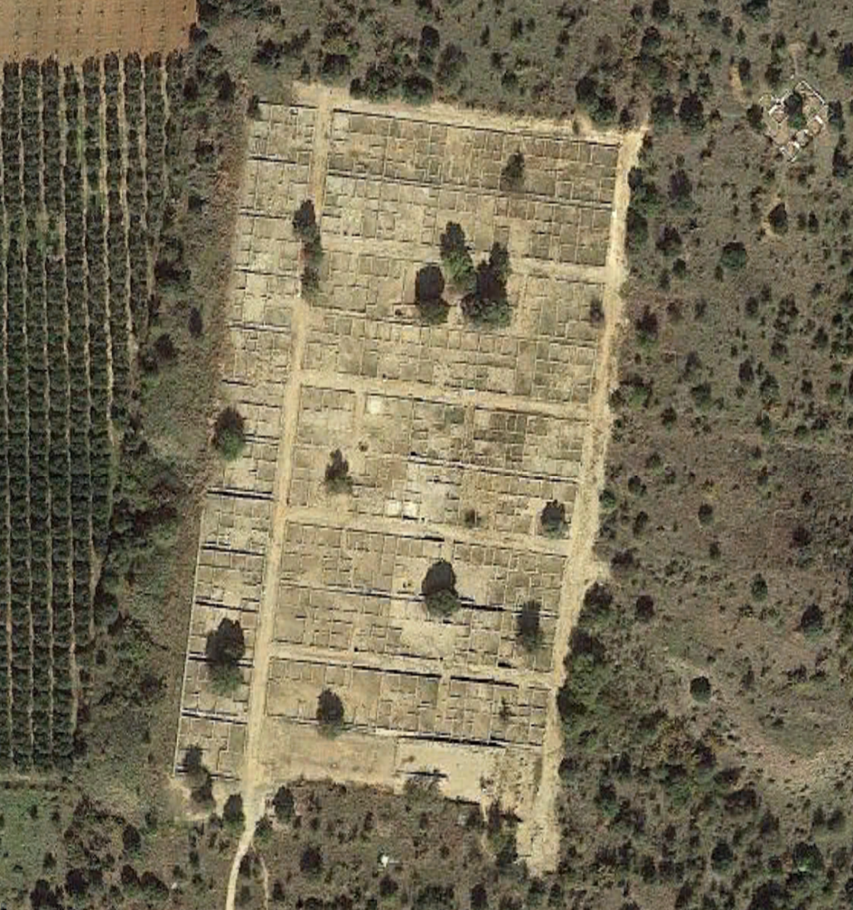

Slide 10
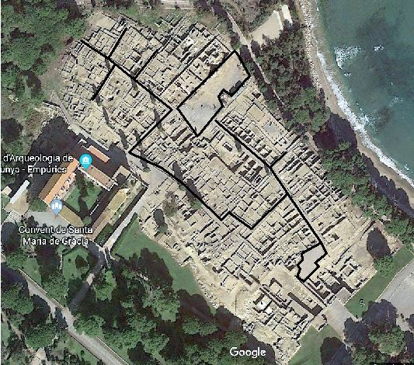
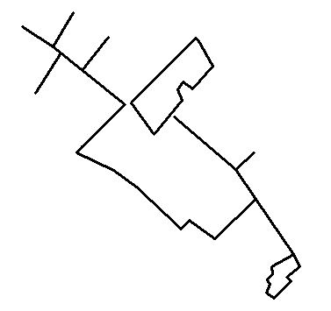
Street Layouts

Slide 11
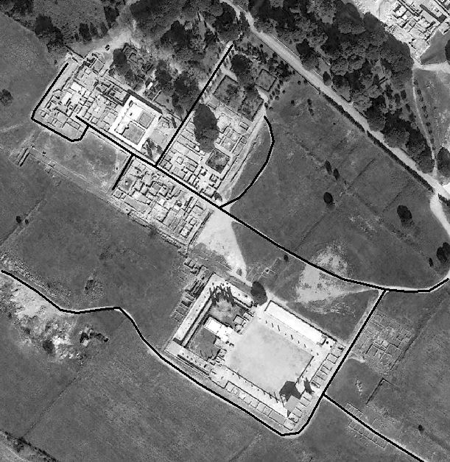
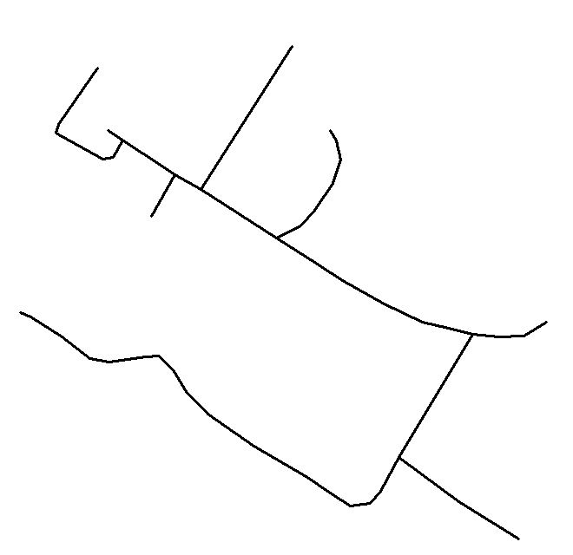

Slide 12
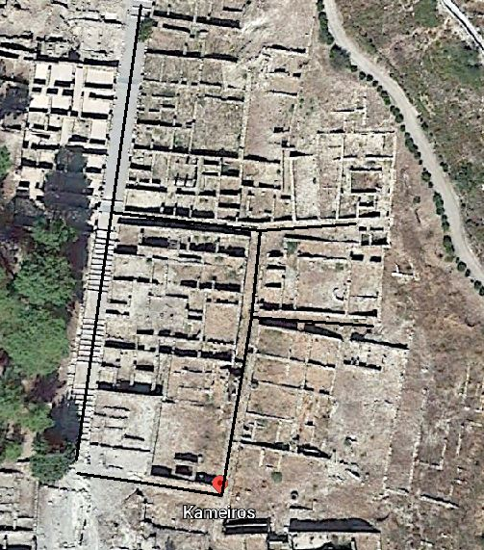
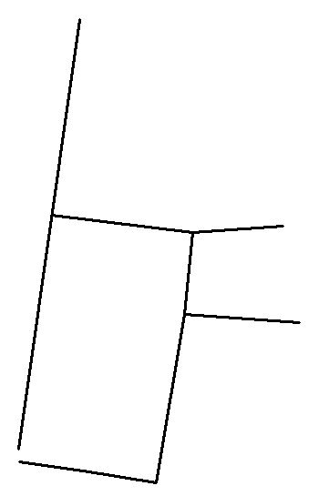

Slide 13
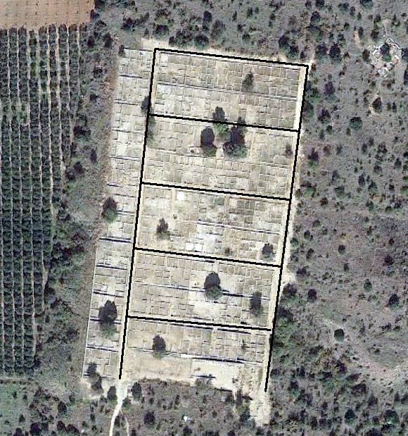
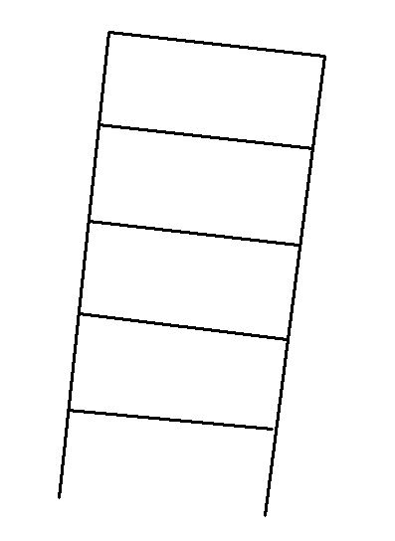

Slide 14
Conclusions
Very little evidence of Plato’s ideas.
Stronger evidence of Hippodamus’s ideas.
More research should be done.
GIS is a helpful resource that should be used more.
Notes:
Doesn’t mean that Plato’s ideas aren’t relevant. More research should always been done..

Slide 15
Bibliography
Cahill, N. 2002. April 10. Household and City Organization at Olynthus. Yale University Press.
“Hippodamus of Miletus.” Wikipedia. 16 April, 2018. Web.
Lahanas, Michael. “Town (or Urban) Planning in ancient Greece.” Hellenica World. 16 April, 2018. Web.
“Make Your Own Maps of Corinth and Greece.” The American School of Classical Studies at Athens. 16 April, 2018. Web.
Plato. and Lee, H. (1974). The Republic. Harmondsworth: Penguin.
Stergiou, Margarita. “What if Ancient Greeks had GIS Technology?” GIS Lounge. 13 November, 2013. 16 April, 2018. Web.

